Slide 1
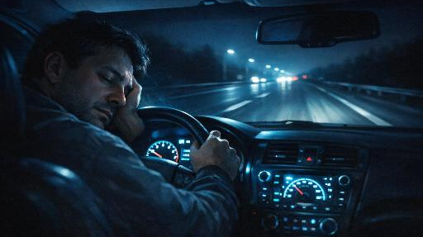
ANTI SLEEP SYSTEM
Driver Drowsiness Detection & Automatic Braking System
Graduation Project 2026

Slide 2
THE PROBLEM
Drowsy Driving: A Silent Killer on Roads
1.19M
17.6%
6,400
91K
Road Deaths
Annually Worldwide
Fatal Crashes
Involve Drowsy Drivers
Annual Deaths from
Drowsy Driving (US)
Police-Reported
Drowsy Crashes/Year
Key Facts
20 hrs without sleep = 0.08% BAC
1 in 25 adults fell asleep driving
Ages 18-25: 2.4x more likely
$109B annual cost (NHTSA)
Peak risk: midnight to 6 AM
Sources: NHTSA, AAA Foundation, WHO Global Road Safety Report 2023, CDC

Slide 3





PROJECT OVERVIEW
How It Works
IR sensor detects eye closure (drowsiness signal)
Buzzer + Vibrator trigger alert to wake the driver
Relay cuts motor power, stopping the wheel (braking)
Arduino UNO processes all signals in real-time
Goal: Prevent accidents caused by drowsy driving through real-time detection and automated response

Slide 4
SYSTEM WORKFLOW
01
02
03
04
DETECT
→
PROCESS
→
ALERT
→
BRAKE
IR sensor monitors
eye state continuously
Arduino reads sensor
and evaluates status
Buzzer sounds and
vibrator activates
Relay cuts power
to motor/wheel
EYES OPEN → SAFE
EYES CLOSED → DANGER
Motor runs normally, alerts off
Motor stops, buzzer + vibrator activate

Slide 5
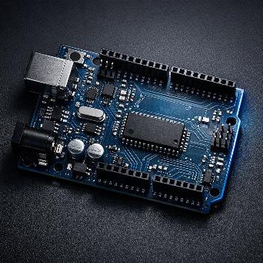
SYSTEM COMPONENTS
Part 1: Core Electronics
Arduino UNO
Main microcontroller — reads sensor data, controls relay and alert systems
IR Obstacle Sensor
Detects eye closure by sensing proximity changes via infrared light
Active Buzzer
Emits loud alarm sound when drowsiness is detected
Vibrator Motor
Provides physical vibration alert to wake the driver
Mini Breadboard
Prototyping platform for connecting components without soldering

Slide 6
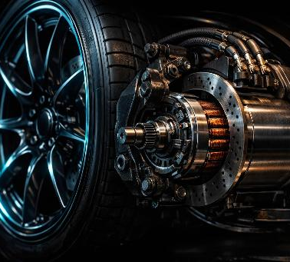
SYSTEM COMPONENTS
Part 2: Power & Drive
1-Channel Relay Module
Switches motor power on/off based on Arduino signal
Lithium-Ion Battery (18650)
Rechargeable power source providing stable 3.7V output
Battery Holder
Secures the 18650 battery and connects to the circuit
DC Gear Motor & Wheel
Simulates vehicle wheel — stops when relay cuts power
Jumper Cables (F/F, M/F, M/M)
Various connectors for wiring components together

Slide 7
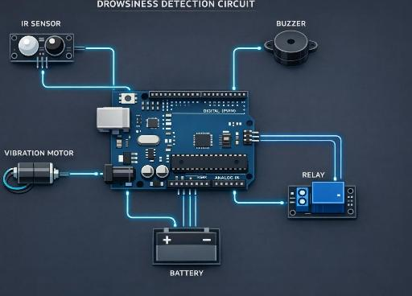
CIRCUIT DESIGN
Pin Connections
D2
IR Sensor (Signal)
D5
Relay Module (IN)
D8
Buzzer + Vibrator
5V
Sensor VCC
GND
Common Ground
Power Supply
18650 Li-Ion Battery
via Battery Holder to Relay → Motor

Slide 8

SOFTWARE & CODE
Arduino IDE — C/C++ Language
const int irSensor = 2;
const int relayPin = 5;
const int alertSystem = 8;
void setup() {
pinMode(irSensor, INPUT);
pinMode(relayPin, OUTPUT);
pinMode(alertSystem, OUTPUT);
digitalWrite(relayPin, HIGH);
digitalWrite(alertSystem, LOW);
}
void loop() {
int sensorValue = digitalRead(irSensor);
if (sensorValue == LOW) {
digitalWrite(relayPin, LOW);
digitalWrite(alertSystem, HIGH);
} else {
digitalWrite(relayPin, HIGH);
digitalWrite(alertSystem, LOW);
}
}
Code Logic
1
Pin Setup
IR sensor on D2, relay on D5, buzzer+vibrator on D8
2
Normal State
Motor runs (relay HIGH), alerts off (LOW)
3
Eye Closed Detected
Sensor reads LOW → stop motor + activate alerts
4
Eye Open Detected
Sensor reads HIGH → resume motor + deactivate alerts
5
Real-Time Loop
Continuous monitoring with instant response

Slide 9
ADVANTAGES & FEATURES
Why This System Stands Out
Real-Time Monitoring
Automatic Alert System
Continuously tracks driver eye state using IR sensor with instant response to drowsiness detection
Dual alert via buzzer sound and vibration motor ensures the driver is woken up through multiple senses
Low Cost Solution
Easy to Implement
Built with affordable components like Arduino UNO, IR sensor, and basic electronics - accessible for widespread adoption
Simple circuit design and straightforward Arduino code make this project reproducible and easy to scale
Improves Driver Safety
Actively prevents drowsy driving accidents by combining detection, alert, and automatic braking — addressing one of the leading causes of road fatalities worldwide
A practical, affordable solution that can save lives on the road

Slide 10
CHALLENGES FACED
Problems We Encountered During Development
01
Sensor Calibration
02
False Detection
The IR sensor required precise distance calibration to accurately detect eye closure without triggering false alarms from ambient light or head movements.
Blinking or looking down sometimes triggered false positives. We adjusted sensor sensitivity and positioning to minimize incorrect alerts.
03
Relay Response Delay
04
Power Stability
The relay module had a slight switching delay when cutting motor power. We optimized the code to trigger the relay as the first action for faster response.
The 18650 battery voltage fluctuated under load when the motor and buzzer ran simultaneously. We ensured proper grounding and considered adding a voltage regulator.

Slide 11
FUTURE IMPROVEMENTS
Next Steps to Evolve This Project
Camera-Based Detection
AI Eye Tracking
GSM Emergency Alert
Replace IR sensor with a camera module for more accurate facial recognition and eye-tracking capabilities
Integrate machine learning models to detect drowsiness patterns, yawning, and head-nodding with higher accuracy
Add GSM module to automatically send SMS alerts with location to emergency contacts when drowsiness is detected
Mobile App Integration
GPS Location Tracking
Develop a companion smartphone app via Bluetooth to monitor driving sessions, track drowsiness events, and provide driver fatigue analytics
Integrate GPS module to log the exact location of drowsiness incidents and share real-time coordinates with emergency services

Slide 12
Anti Sleep System in Action

Slide 13

THANK YOU
Anti Sleep System
Questions & Discussion

